Slide 1
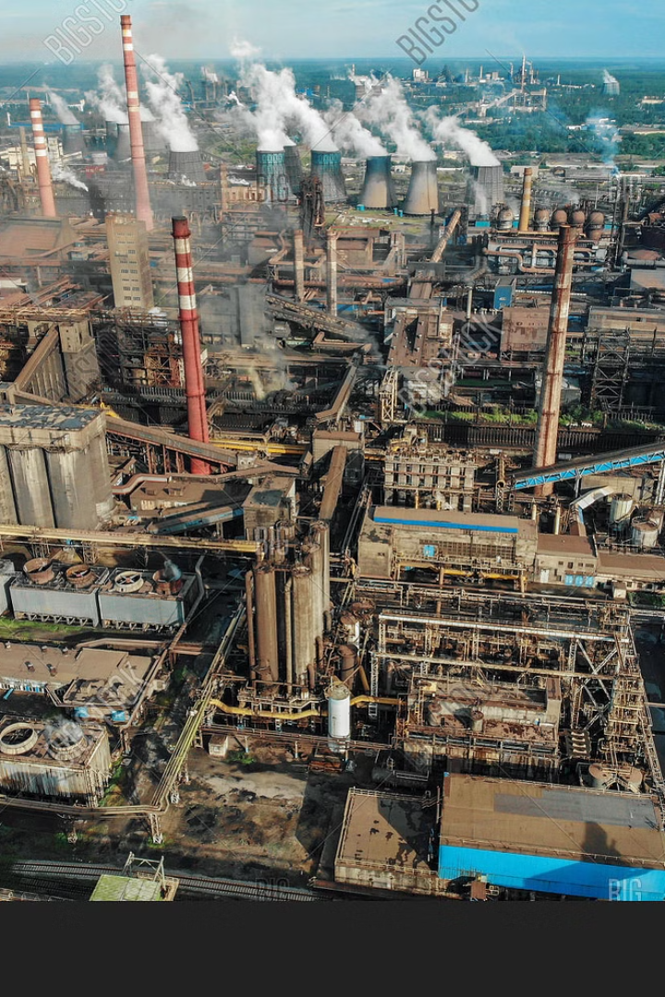
Industrial Site Analysis
KONDETI VENKAT - S20210010125
DIVVELA SUMANTH - S20210010067
BUKKE PRAJWAL NAIK - S20210010047

Slide 2

Objective
The primary goal of this project is to harness geospatial technology and satellite imagery to pinpoint and analyze which locations are suitable for constructing industries. This entails integrating various vector layers, including road networks, land use classifications, vegetation cover, water bodies, topographic and colleges related to industrial zones . The project aims to examine spatial patterns and characteristics associated within these industrial locations. the project seeks to pinpoint areas within the study area that exhibit suitable for industrial site analysis.

Slide 3
Methodology
Data acquisition
1
Obtain satellite image and relevant geospatial datasets.
2
Layer Generation
Generate necessary layers for analysis (e.g., Transportation ,land cover).
Preparing Data for ML Analysis
3
preprocess the acquired data to ensure consistency and quality, and prepare it for analysis with ML algorithms.
4
Feature Selection and Model Training
Extract relevant features from the satellite image.

Slide 4
Methodology(Continue..)
Raster Classification
5
Apply the trained ML models to classify pixels or areas in the satellite imagery or DEM into different classes.
6
Raster Analysis
Analyze Elevation data using raster techniques.
Identification of Industrial Sites
7
Integrate results to locate Industrial Sites
8
Vector Analysis
Overlay datasets and conduct spatial analysis (e.g., Union ,Intersection, Difference ,Clip and Dissolve).
WebGIS Interface Developement
9
Develop a web-based GIS interface for data visualization and user interaction

Slide 5
Criteria Used
Away From Sea
Away From Hospitals ,Tourism spots ,Colleges , Population
Near to small water bodies ,Power Stations, Transportation
Away From Vegetation , Shopping complexes
Away From Topographic , Coastline and forests

Slide 6
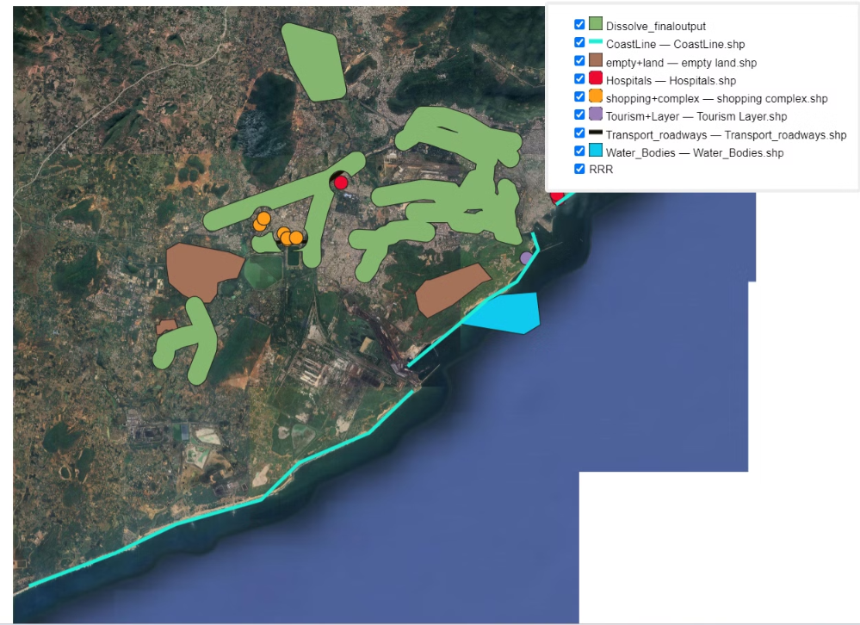
Individual Contribution
1. KONDETI VENKAT

Slide 7
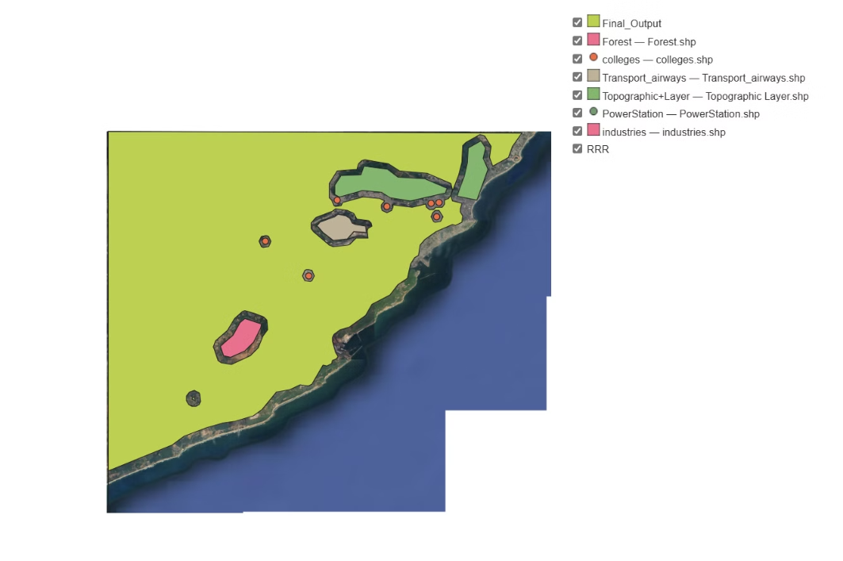
Individual Contribution
2. DIVVELA SUMANTH

Slide 8
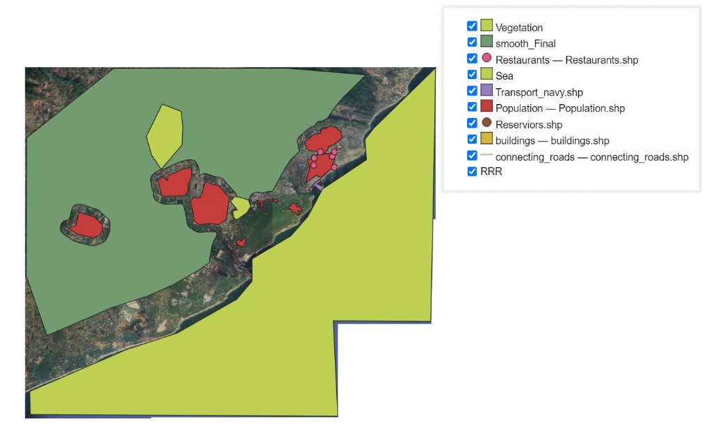
Individual Contribution
3. PRAJWAL NAIK

Slide 9
Vector Layers
Colleges
Coastline
Connecting road
Industries
Transport roadways
Reservoir
Forest
Empty Land
Sea
Topographic layer
Hospitals
Transportation Navy
Power station
Shopping complex
Population
Transport airways
Water bodies
Restaurants
Area Layer
Tourism layer
Vegetation

Slide 10
Raster Layers
1
Digital Elevation Model
2
Google Satellite

Slide 11
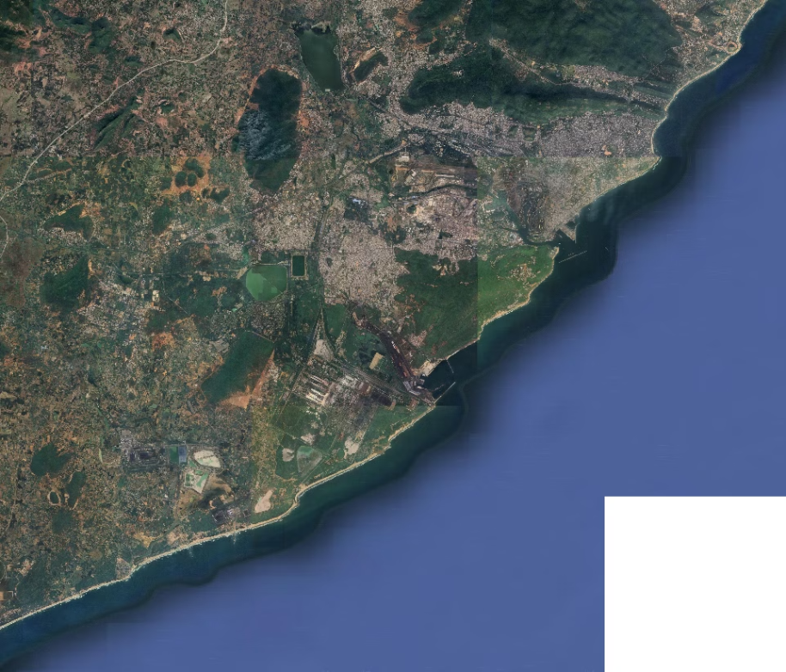
Study Area

Slide 12
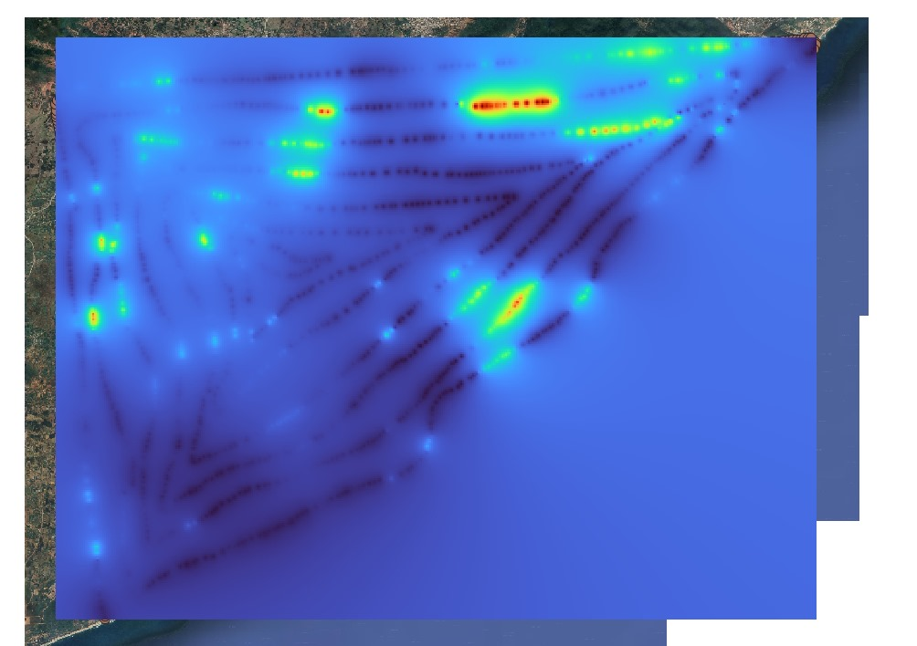
Digital Elevation Model

Slide 13
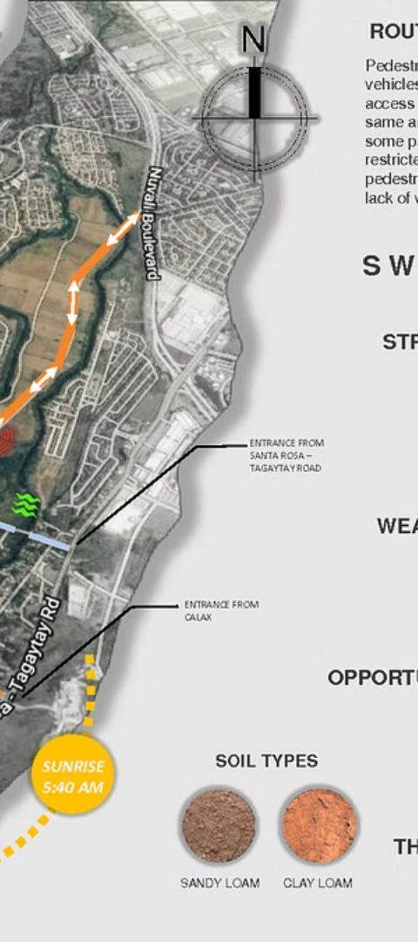


Analysis
Raster Calculator
Comprehensive evaluation of the site's geographic features, transportation networks, and utility infrastructure to identify strengths and weaknesses.
Reclassify by Layer
Thorough examination of the site's topography, and potential environmental impacts to ensure sustainable development.

Slide 14
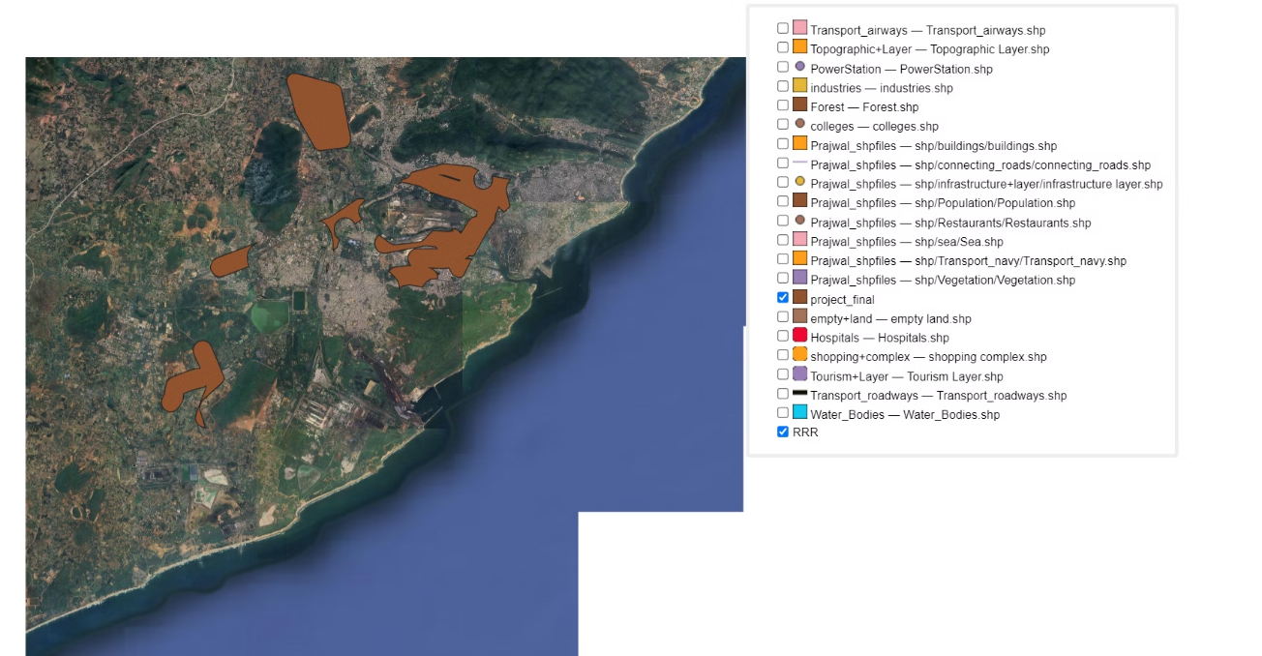
Final Result

Slide 15
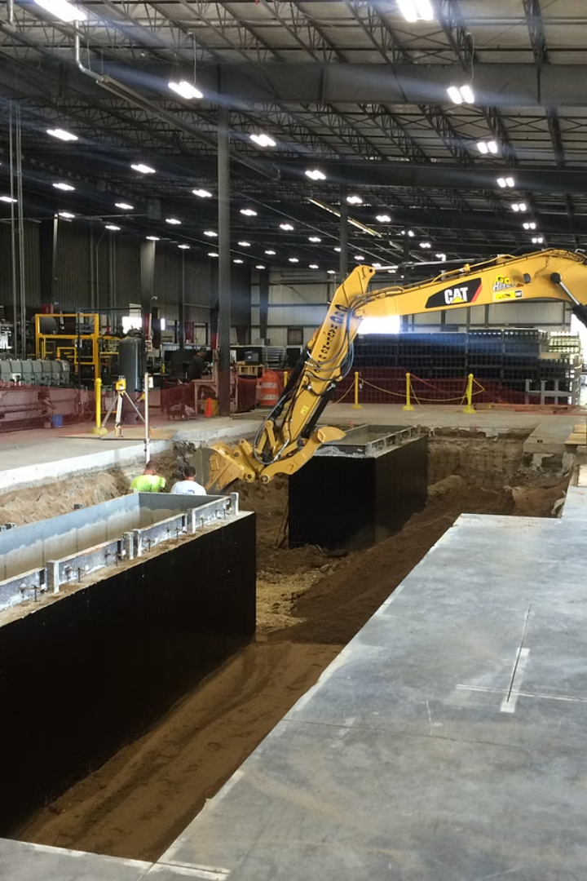
Thank You
Thank you for the opportunity to analyze this industrial site. Our comprehensive assessment has identified the key strengths, challenges, and opportunities to optimize the site's potential for successful industrial development.

